Slide 1
Student Behaviour Analysis
Capstone Project Group 8

Slide 2
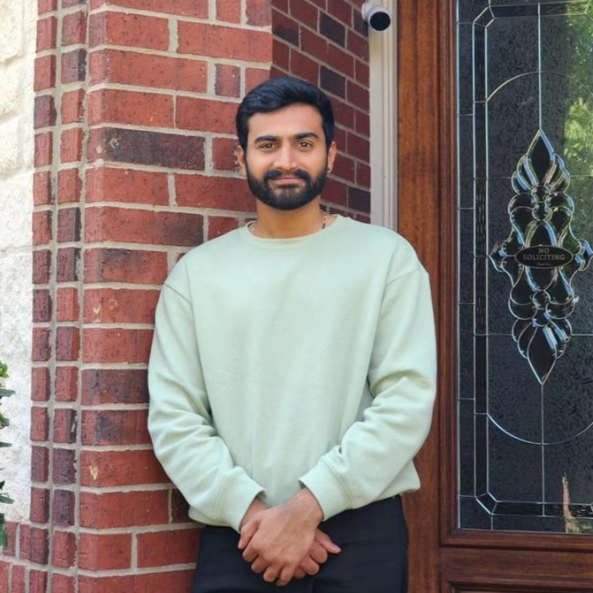

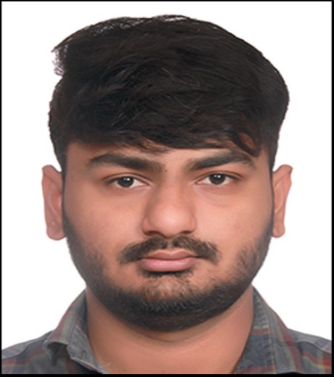
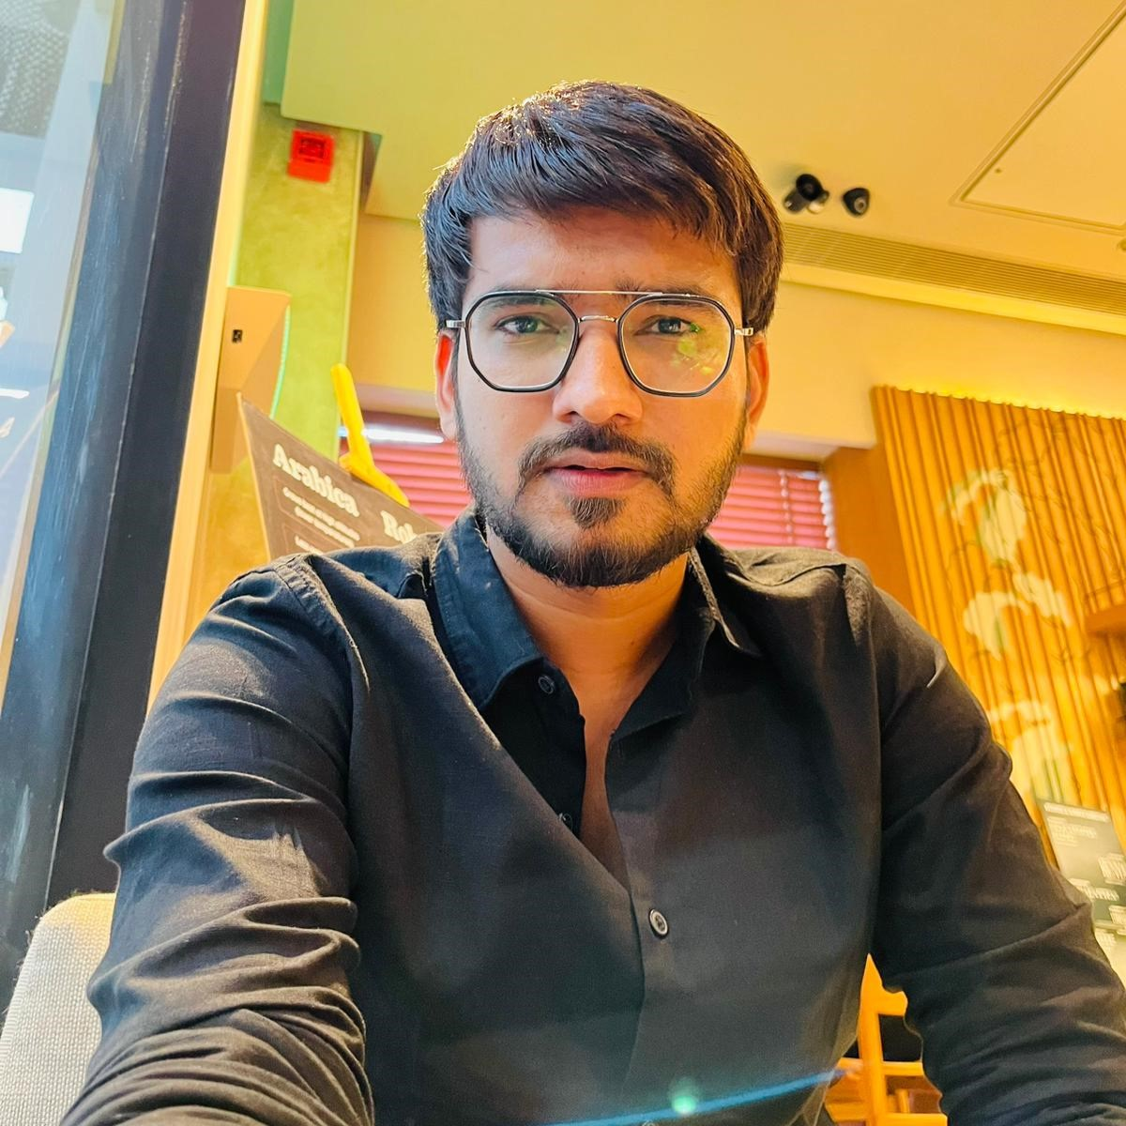
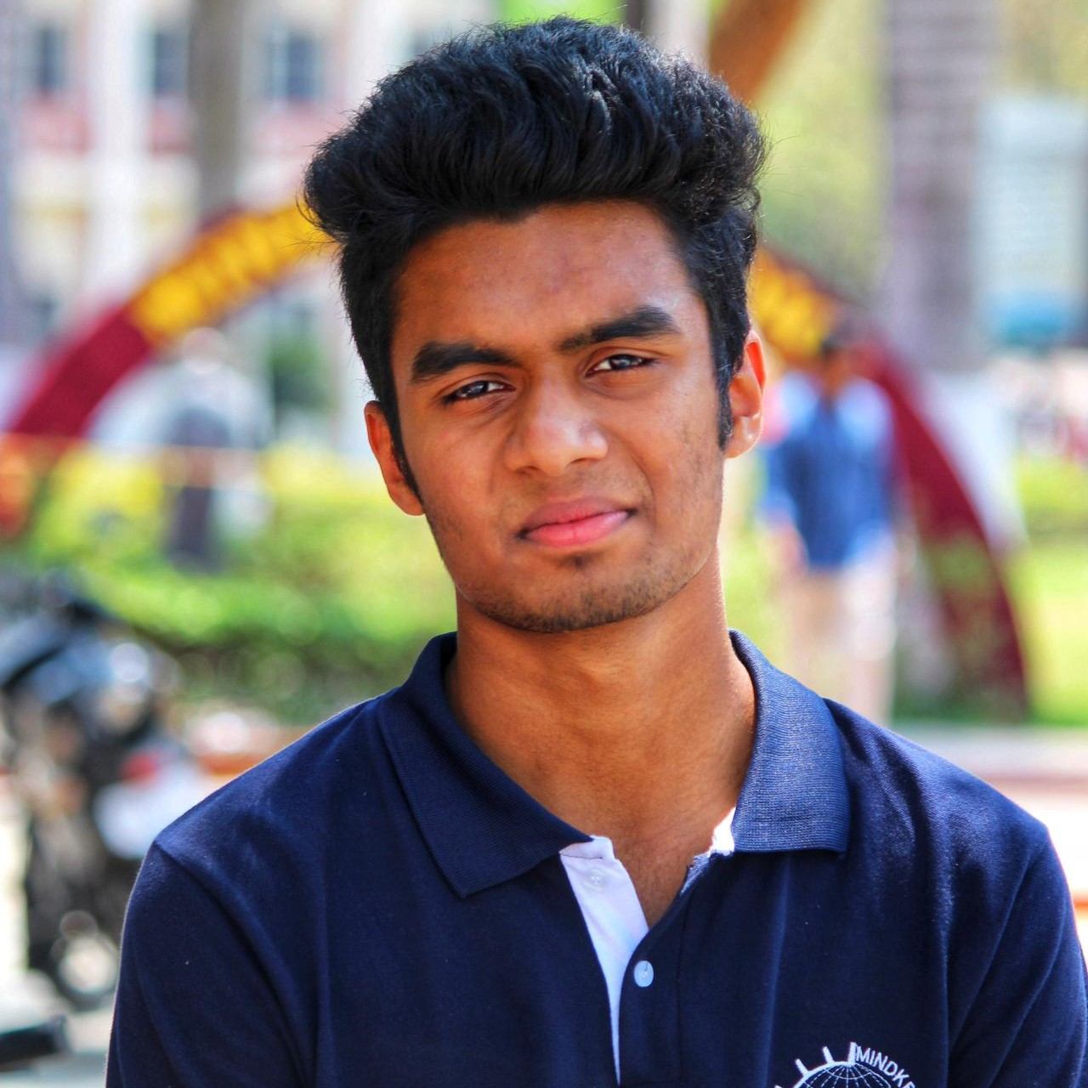
Student Behaviour Analysis
Capstone Project Group 8
Archit Navadiya (0815897)
Dhrumil Patel (0813662)
Bhumit Navadiya (0812548
Arbaz Shaikh (0823127)
Felix Saji (0803791)

Slide 3
TABLE OF CONTENTS
01
02
03
05
PROJECT OVERVIEW
METHODOLOGY
06
PROBLEM STATEMENT
ML IMPLEMENTATION
07
DATA EXPLORATION
CHALLENGES FACED
04
08
SOLUTION PROVIDED
FUTURE WORK

Slide 4

PROJECT OVERVIEW
Main goal of the project is to analyze and enhance the Zekelman School of IT's facilities and student experience by assessing student satisfaction and identifying improvement areas in facilities and support services.
We are utilizing Microsoft Forms to conduct an online survey among all IT program students, covering topics such as program satisfaction, faculty interactions, facility usage, support services, and overall student experience. Power Automate and Azure will be used for automated data gathering process.

Slide 5




PROBLEM STATEMENT
This research delves into the encounters of students at Zekelman School of Information and Technology regarding demographics, housing, accessibility, work opportunities, and academic pursuits. The goal is to pinpoint obstacles, enhance support structures, and elevate overall contentment and achievement, ultimately leading to a deeper comprehension of student welfare.
Demographics
- program, country, age, gender, etc.
Accommodation & Convenience
- type of accommodation, rent, amenities
Employment & Scholastics
- status, average income, services provided by college

Slide 6

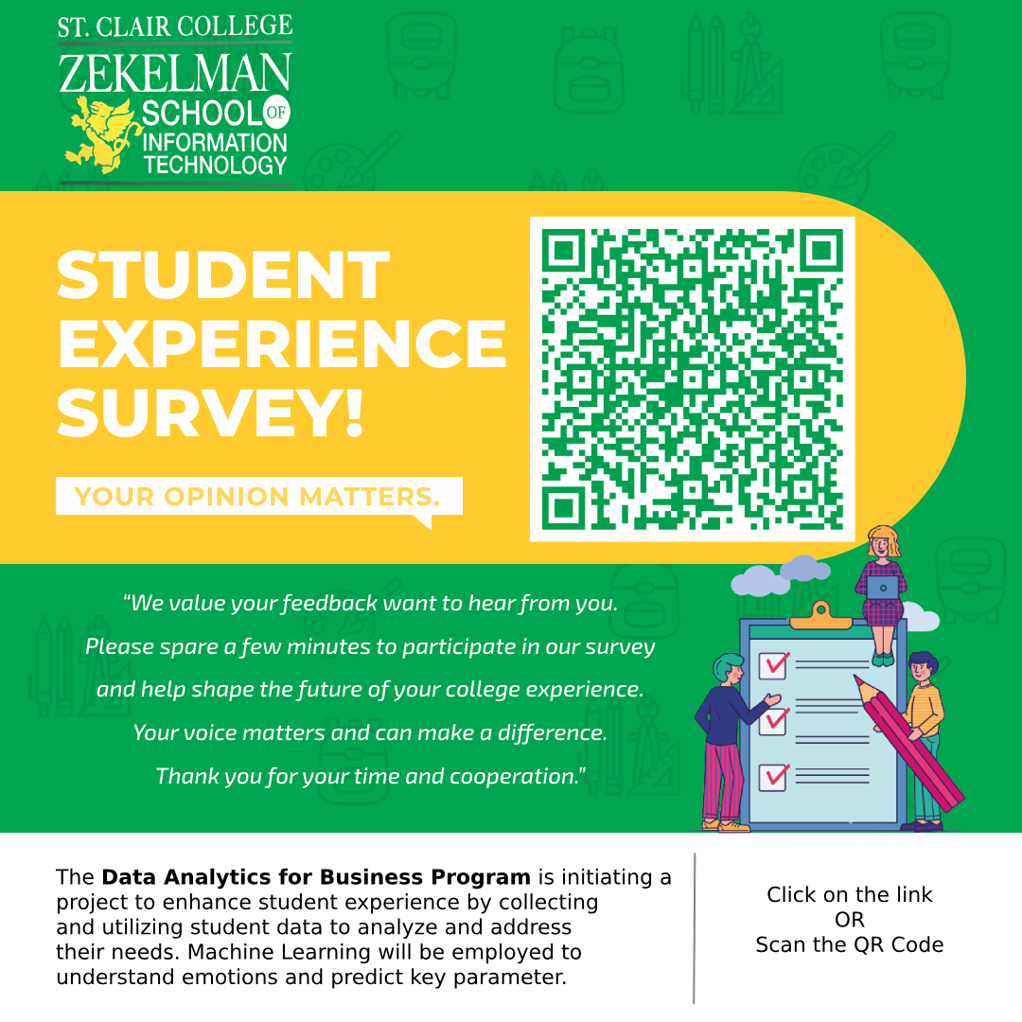
DATA EXPLORATION
01
02
03
Demographics Table | Accommodation Table | Academic Table
Contains personal characteristics data. Age Gender Education level Professional experience | Provides insights into housing situations. Accommodation type Rental prices Commute reliability | Focuses on academic statuses and experiences. Employment Status Workload expectation Feedback on services

Slide 7
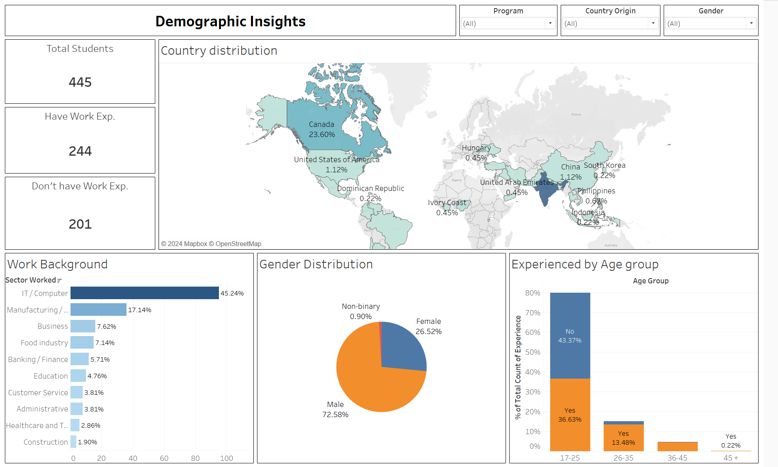
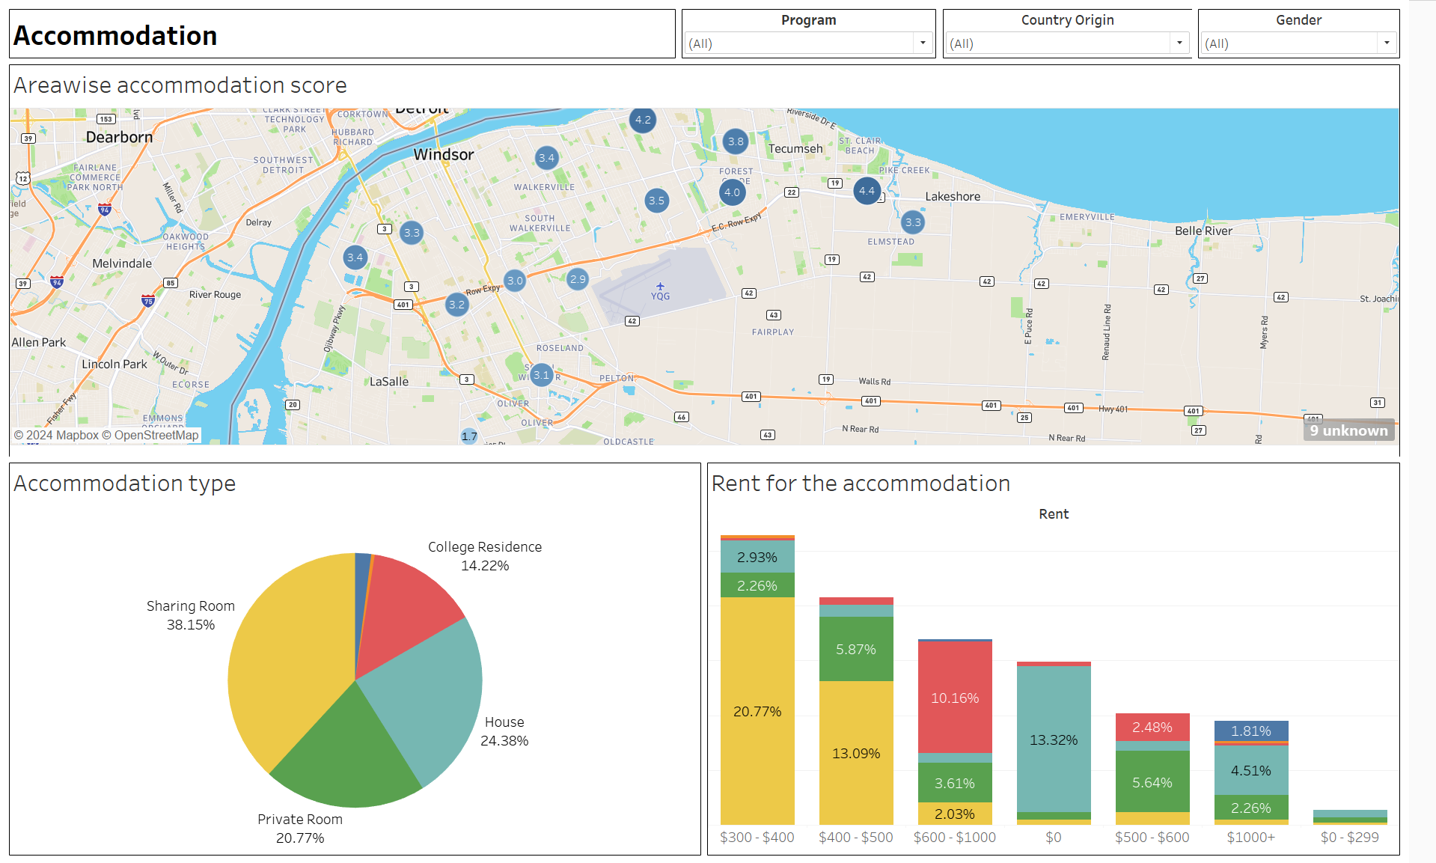
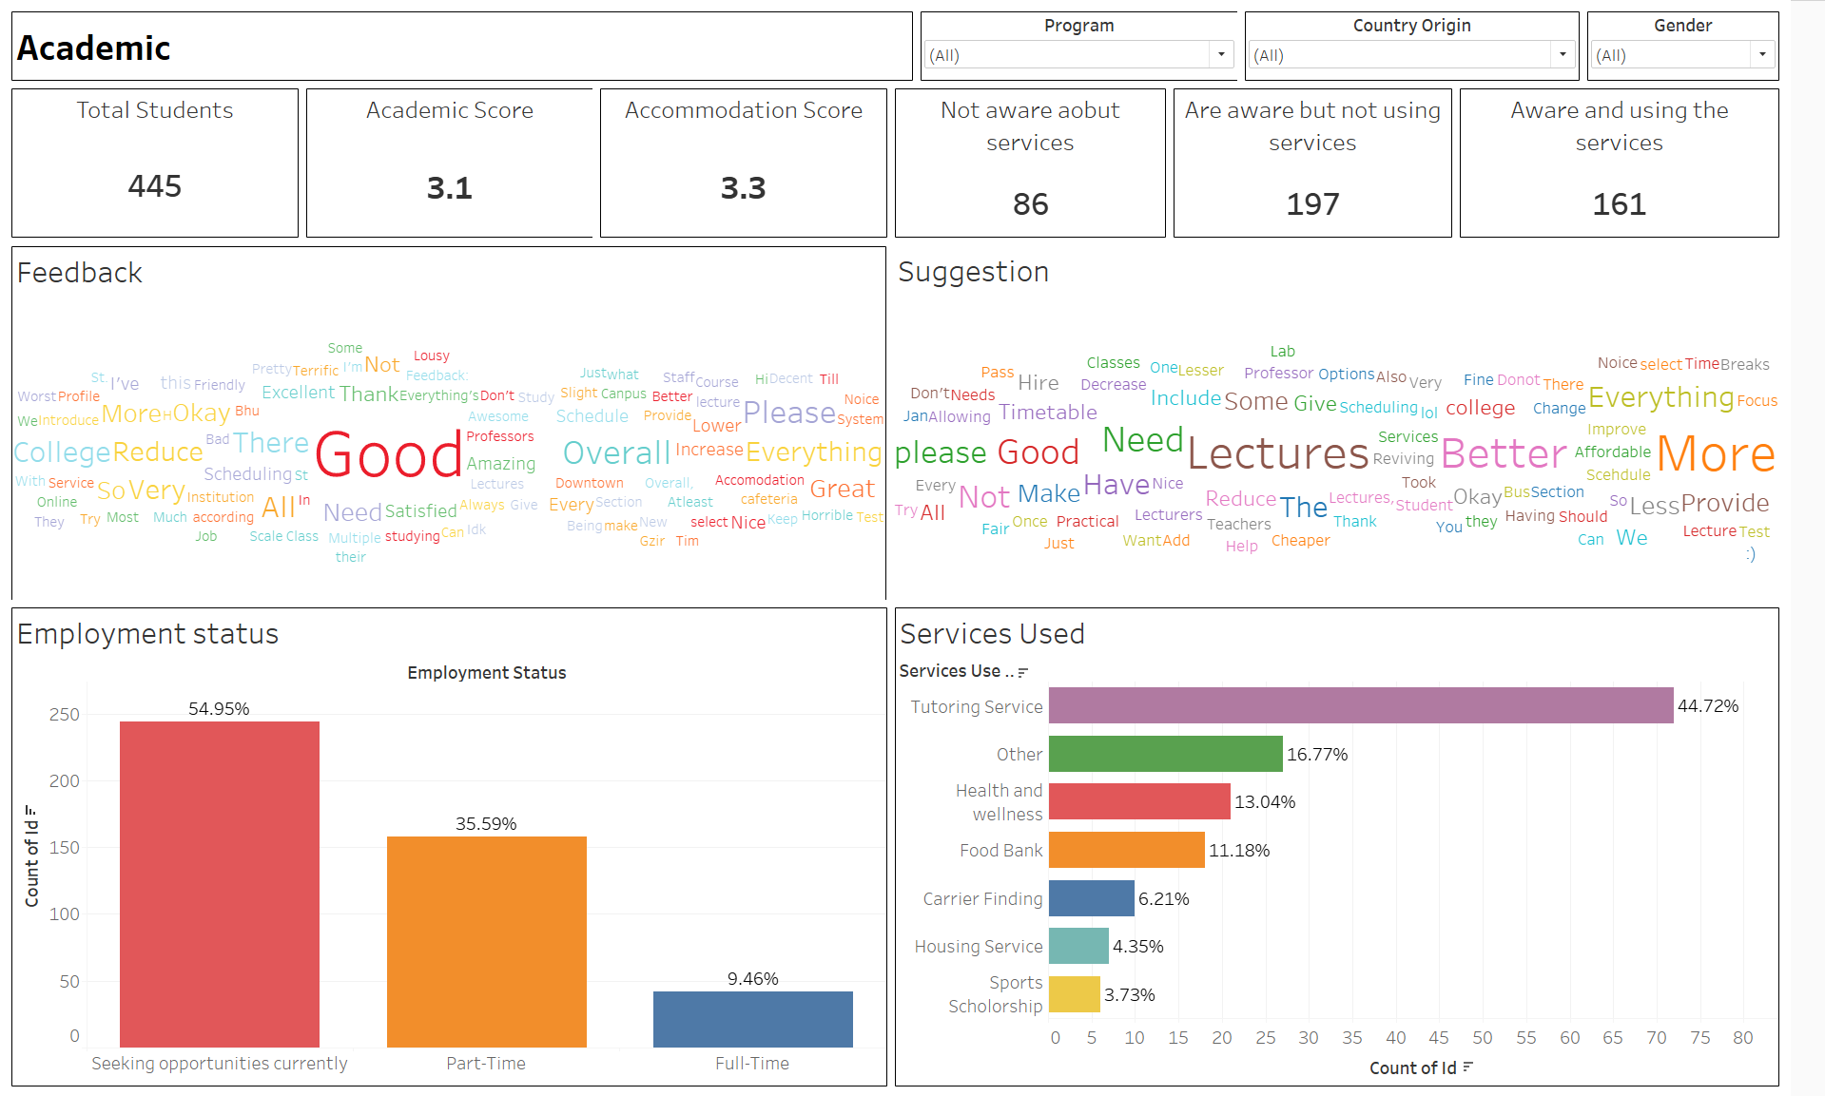
SOLUTION PROVIDED
We aim to provide an automated system that can effectively demonstrate how different factors are connected to a student's college journey, as well as predict how these factors can impact the student.
Not only this will help college make informed decision but will also showcase the student-college relationship.
Dashboards that provide detailed insights from demographic to academic.
DASHBOARDS
DEMOGRAPHIC
ACCOMMODATION
ACADEMIC

Slide 8


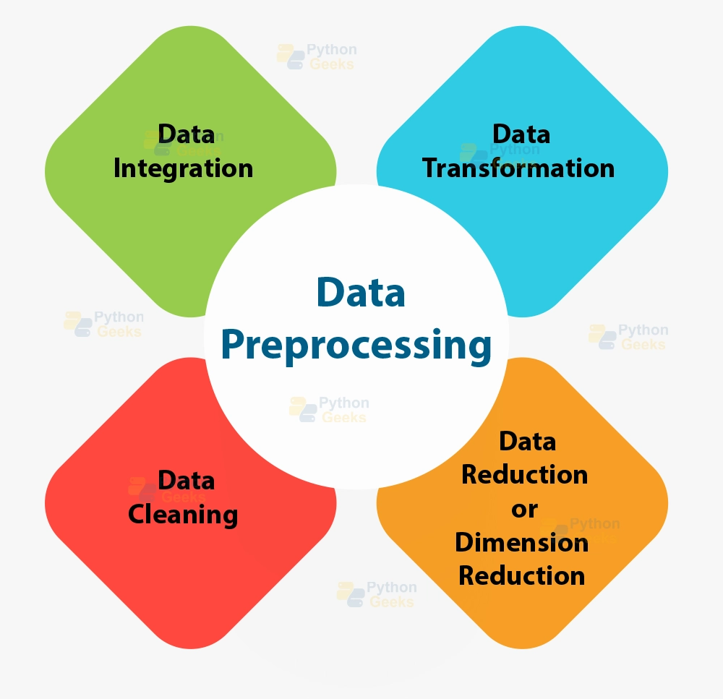







METHODOLOGY
Data Flow
Technologies
Methods
We used MS Forms to create the survey and collect the data.
With power automate we connected our forms to azure database that will automatically fetch responses from forms when a student fills it.
We used azure to store our data and then we connected our database using python for data cleaning. After cleaning the data, we stored it back into azure database.
With Tableau we made interactive Dashboards to showcase the analysis.
Data Collection
MS Forms
Data Preprocessing
Power Automate
MS Azure
Data Transformation
Python
Prediction
Tableau
Presentation

Slide 9
ML IMPLEMENTATION
Statistical Analysis
Predictive Modeling
NLP Analysis
Through hypothesis testing, we examined correlations between demographic features (gender, age group, experience, education level, and course) and Academic and Accommodation Scores to understand their influence on student satisfaction and performance.
We utilized decision tree regression, KNN Regression, Gradient Boosting Regression, Neural Network, and CNN models to forecast the Overall Academic Score.
Employing NLP, we analyzed student feedback to identify preferences and dislikes, aiding in targeted improvements for academic and accommodation experiences.

Slide 10
CHALLENGES FACED
Data Collection
Not getting enough responses with old technique.
Schedules not matching for the new technique.
Overcame this by dividing the group and going from class to class.
Data Processing
Overspending on data cleaning process.
Overcame this by implementing a cap on budget.

Slide 11

FUTURE WORK
Our future steps involve incorporating all programs offered by St. Clair College, not just limited to Windsor. We aim to expand our research to include campuses in additional cities, enabling a comprehensive understanding of students' needs and preferences across various programs and locations.

Slide 12
THANK YOU
Prof. Manjari Maheshwari for being the best guide throughout the project.
Chairperson Ruth Sussanah for making this project possible.
Prof. Amit Sharma and team.
Melissa McNamara for helping us get the schedules.
All the students for participating in the survey.

